Slide 1
USING CCTV TO Autonomously Secure environments from internal and external human threats
Dissertation – joe honour
B3029153
Newcastle university
Notes:
How does current video security work?
We often place CCTV in work environments and at our homes in the hope that if something HAPPENS we have traceability of the crime in order to catch the perpetrator, but isn’t this counter intuitive?
We know what a normal work day looks like, or a normal day at your home looks like; who should be there? Where are they normally situated at what times?
So why can’t we teach a machine to see this common behavior and alert us in real time when something out of the usual occurs?
Step In: Machine learning and this dissertation topic – developing the new “PreCrime” police department (Minority Report).
So what is our aim/hypothesis towards achieving this goal?

Slide 2
Estimated 1.85 million CCTV cameras in the UK
Estimated 1.7 million privately owned cameras in the UK
Estimated 33 thousand publicly owned cameras in the UK
Estimated 115 thousand cameras on public transport in the UK
In 2009, 1 crime was solved for every 1000 CCTV cameras
We need to become preventative rather than reactive
CONTEXT
Notes:
CONTEXT FOR THE PRODUCT
Referenced 5.9 million from: http://www.wired.co.uk/article/one-nation-under-cctv
Camera numbers: http://www.npcc.police.uk/ThePoliceChiefsBlog/GraemeGerrardsCCTVblog.aspx
http://www.politics.co.uk/reference/cctv
http://www.independent.co.uk/news/uk/home-news/cctv-cameras-help-to-solve-one-in-every-1000-crimes-1776678.html

Slide 3
DEVELOP A MACHINE LEARNING APPLICATION THAT IS ABLE TO DETECT real-time anomalies in user behavior.
Aim
Notes:
So this title is rather large but we can see to achieve this we have 3 major problems to overcome:
1. We need to be able to identify users in a video to be able to track their behavior.
2. We need to be able to classify an individual users behavior as normal or abnormal.
3. We need a way of notifying an invested user when abnormal or unexpected behavior occurs.
If we are able to achieve this we accomplish our initial goal. So how can we turn this into trackable objectives ?

Slide 4

1
2
3
4
5
Research video processing techniques and available software.
Research machine learning techniques for detecting anomalies in cross section data.
Develop testing data to allow the evaluation of machine learning models.
Develop Micro-services that encapsulate video processing and machine learning.
Evaluate the applications ability to detect anomalies and alert users.
OBJECTIVES
Notes:
What we DON’T Need:
A way of storing video, everything is done in real-time and our machine learning model works solely on the data points produced from the video processing service.
SO we now have a series of objectives to achieve our goal of “PreCrime” police division, but how do we physically design and implement a system like this?
Step In Micro services and distributed computing!

Slide 5
technologies
Notes:
ISSUES, RISKS AND EVALUATION
So what does this end up looking like in Production ?
Docker image source: https://www.docker.com/sites/default/files/Whale%20Logo332_5.png
Play image source: https://content.linkedin.com/content/dam/engineering/en-us/blog/migrated/play-logo_0.png
Apache Kafka image source: https://content.linkedin.com/content/dam/engineering/en-us/blog/migrated/kafka-logo-no-text.png
OpenCV image source: https://upload.wikimedia.org/wikipedia/commons/thumb/3/32/OpenCV_Logo_with_text_svg_version.svg/1200px-OpenCV_Logo_with_text_svg_version.svg.png
TensorFlow image source: https://avatars2.githubusercontent.com/u/15658638?s=400&v=4
AmazonWebServices image source: https://www.cloudwards.net/wp-content/uploads/2016/09/AmazonWebservices_Logo.svg_.png
Terraform image source: https://avatars2.githubusercontent.com/u/11051457?s=200&v=4

Slide 6
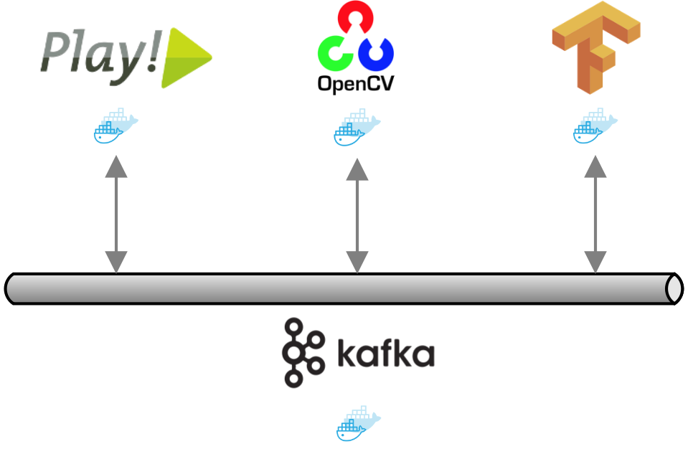
Notes:
MICROERVICE ARCHITECTURE

Slide 7
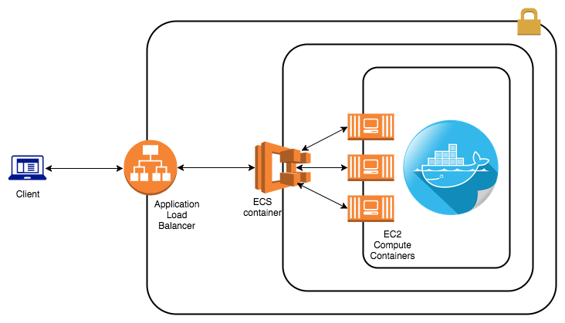
Notes:
As you can see here we have an application load balancer that is able to scale the web traffic to our cluster of Docker images.
These images are ran in high availability mode so we can scale them horizontally as traffic increases.
This provides the flexibility we need to handle large amounts of video throughput.
CLIENT IS A FRONT END WEB APPLICATION
SHOW DEMO OF THIS WORKING THROUGH TERRAFORM AND AWS. (SHOW TERRAFORM BEING RAN, THEN CONTINUE TALKING THEN COME BACK TO SEE THE WEBSITE FULLY RUNNING)
This demo will show what I have done so far.

Slide 8
A Comparative Evaluation of Unsupervised Anomaly Detection Algorithms for Multivariate Data. - Research Article
Data Science from Scratch – Book.
BACKGROUND RESEARCH
Notes:
CURRENT RESEARCH + BACKGROUND READING SLIDE

Slide 9
Video Streaming
Continuous Integration
Production Infrastructure
Video Processing
Machine Learning Model
Integration Testing
TASK BREAKDOWN
Notes:
So what have I completed so far?
What is next to complete?
With these what is the hardest tasks to overcome?
Capturing enough data points to make this feasible.
Creating a model I can train locally and make sure it can make sophisticated classifications.
Investigating the best models to use in conjunction with each other to provide the best results.
Stretch goal: display in a graphical format the behavior patterns to the user.
What methodology with I use to achieve this? Agile. Fail fast.
With that in mind what is my plan moving forward?

Slide 10
10/17
Complete video streaming and initial look at processing
12/17
Scale out video processing to capture as many data points as possible
01/18
Complete Machine Learning proof of concept
Research into machine learning models
03/18
Complete implementation of system
04/18
Begin dissertation write up
Begin implementation of full system with Agile approach
Evaluate system using a test case approach
Notes:
CHANGE TO TIMELINE
CONTIGENCY TIME HAS BEEN MADE IN THESE TIME FRAMES
COMPLEXITY OF TASKS

Slide 11
Questions?
Dissertation – joe honour
B3029153
Newcastle university
Notes:
- Any questions?

